Slide 1
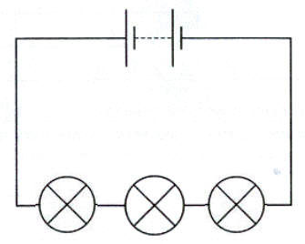

Series circuits
Is your work well presented?
Lesson Objectives
1. Construct and draw circuit diagrams for components connected in series.
2. Explain what happens to current and P.D. in a series circuit.
3. Determine why the current through each component in a series circuit is the same.

Slide 2
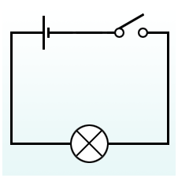

Series circuits.
Achieving Objective 1- Construct and draw circuit diagrams for components connected in series.
In a simple series circuit, everything is connected in one loop across the terminals of the battery. There are no points where the current can split
or join (these are called junctions).
Review
What have we found out?
Is your work well presented?

Slide 3
Series circuits.
Achieving Objective 1
1. Construct and draw circuit diagrams for components connected in series.
Produce this circuit diagram. Draw it in your books.
https://www.youtube.com/watch?v=YAzyHRusOS0
Review
What have we found out?
Is your work well presented?

Slide 4
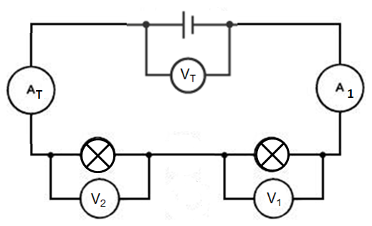
Using your results.
Achieving Objective 2 - Explain what happens to current and P.D. in a series circuit.
Using your results from the investigation explain what happened to the current and voltage when you added another bulb to the series circuit?
Use these equations for ideas
V_{total} = V₁ + V₂ + etc.
I_{total} = I₁ = I₂ = etc.
Review
What have we found out?
Is your work well presented?

Slide 5
Using your results.
Achieving Objective 2 - Explain what happens to current and P.D. in a series circuit.
When another bulb is added to the series circuit the current will stay the same. However the voltage will decrease in the series circuit.
V_{total} = V₁ + V₂ + etc.
I_{total} = I₁ = I₂ = etc.
Review
What have we found out?
Is your work well presented?

Slide 6
Current in series.
Achieving Objective 3 - Determine why the current through each component in a series circuit is the same.
Why is the current still the same even when more bulbs are added?
The current is not used up by the components in a circuit. This means that the current is the same everywhere in a series circuit.
Review
What have we found out?
Is your work well presented?

Slide 7
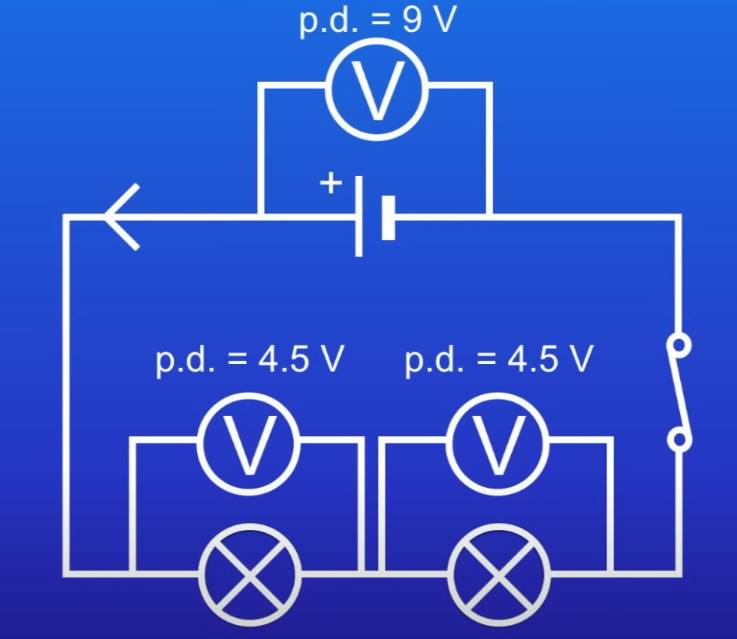
Current in series.
Achieving Objective 3 - Determine why the voltage through each component in a series circuit is reduced.
Why is the voltage reduced when more bulbs are added?
The voltage reduces because the components on the series circuit share the voltage of the battery.
Review
What have we found out?
Is your work well presented?

Slide 8
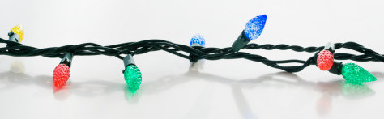
Plenary
What are the advantages and disadvantages in using series circuits?
Lesson Objectives
1. Construct and draw circuit diagrams for components connected in series.
2. Explain what happens to current and P.D. in a series circuit.
3. Determine why the current through each component in a series circuit is the same.

